Slide 1
Achieving
Whole Community Inclusion in Emergency Management

Slide 2
Learning Objectives
Understanding equity and inclusion (equality) and identifying your subject matter experts in both disciplines
Learning strategies to ensure you are effectively planning for everyone in your community

Slide 3
Whole Community in Emergency Management
Planning with the whole community
Ensuring inclusion in your agency’s core capabilities
Inclusion assigned as a responsibility for a member of your team
Dedicating a full-time position that focuses on ensuring equity and equality is considered in all phases of emergency management
Colorado blueprint that can help you achieve a similar outcome in your state

Slide 4
Planning with The Whole Community
Incident Command System (ICS) relationships
FEMA/State/Local
Emergency Management plans
Colorado Emergency Preparedness Assessment (CEPA)
Haz-Mat plans- Hazardous Materials Plans
Threat and Hazard Identification and Risk Assessment (THIRA) - Stakeholder Preparedness Review (SPR)
Access & Functional Needs Planning tool
Community Inclusion in Colorado: Resources and Maps/Geographic Information System (GIS) data
Cross relationship
Emergency Support Functions (ESFs)
Stakeholders

Slide 5
Ensuring inclusion in your agency’s core capabilities
Center for Independent Living
How and who can fill that gap
Small Dollar Grant Awards (SDGA), Emergency Management Performance Grant (EMPG)
Section 504 of rehab act is included in deliverables
How is it funded
Memorandum of Understanding (MOU)/MOA Memorandum of Agreement
Contracted correctly for Public Assistance eligibility
Section 504 of Rehab act is included in deliverables
Managing expectations knowing your limits

Slide 6
Inclusion assigned as a responsibility for a member of your team
Not “other duties as assigned” otherwise it does not get done
Requires a person to coordinate
Problems with ADA coordinators
Supports the how-tos tied to laws and regs for Whole Community Inclusion
Section 504 of rehab act
ADA
effective communication
Section 508 of rehab act
Colorado’s Growth story
1 AFN Coordinator to piloting…..

Slide 7
Position that focuses on ensuring equity and equality in all phases of emergency management
Lessons learned from real world examples
National Access & Functional Needs Meeting due to concurrent disasters and pandemics e.g. COVID
Personal Protection Equipment (PPE) gap to Home & Community Based Services (HCBS) community members
Language access
Data collection -Social Vulnerability Index (SoVI)
Age
Disability
Ethnicity
Access to food during lockdown for those without transportation resources (CMIST- Communication, Maintaining Health, Independence, Support Services, Safety, Transportation resources )

Slide 8
Colorado blueprint that can help you achieve a similar outcome in your state
Access & Functional Needs (AFN) Coordinator in ESF-5 in the plans section in the State Emergency Operations Center (SEOC)
Training on how an AFN Coordinator is “people resource” vs AFN/ADA Police
Filled the ICS coordination- ESF, Regional Disability Inclusion Specialist, Civil Rights Advisor, -Intercore Group
Community Based Testing sites
Alternative Care Facilities/ Sites
Vaccination Sites
Joint Information Center inclusion/ESF-8
Listening session our statewide AFN/CMIST resource and information sharing meeting
Lessons Learned sessions during the event

Slide 9
Call to Action Steps
Have a local/state level Whole Community in Emergency Management conversation and action plan
Join the National AFN Call to help support
3rd Monday of the Month 2PM ET/ 11AM PT
Notes:
What is whole community mean
AFN is not a label
Get a Person specific to WCI

Slide 10
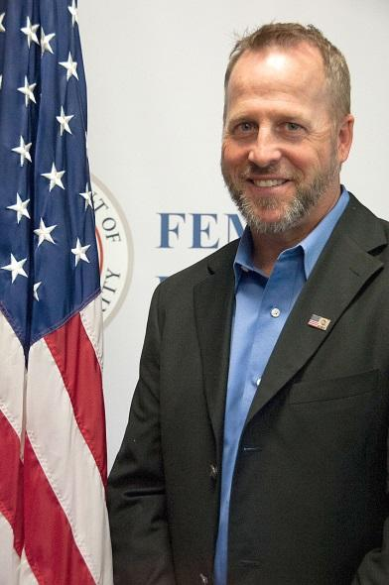
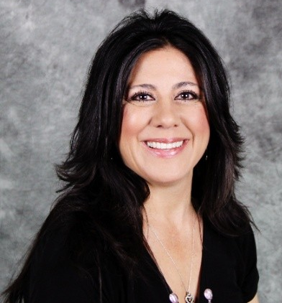
Questions?
Michael Houston
Region 8 Disability Integration Specialist
FEMA
C 202.440.2740 Michael.Houston@fema.dhs.gov
Sadie Martinez
Access & Functional Needs Coordinator
Colorado Office of Emergency Management
C 720.610.1691
sadie.martinez@state.co.us

